Slide 1



Bangalore Institute of Technology
Department of Artificial Intelligence & Machine Learning
K.R. Road, V.V.Pura, Bengaluru-560 004
Advanced Machine Learning(18AI72)
Mini Project on
"Customer Segmentation Using Machine Learning”
Presented by
Batch No - 19
Bhavika Paladugu 1BI20AI007
Dhanyashree P N 1BI20AI011
VII Semester

Slide 2


Contents
INTRODUCTION
PROBLEM STATEMENT
PROPOSED METHODOLOGY
SYSTEM REQUIREMENTS
ARCHITECTURE
MODULE DESCRIPTION

Slide 3

Introduction
In the dynamic landscape of business and marketing, understanding customer behavior is crucial for creating effective strategies that resonate with diverse consumer preferences.
This project employs the K-Means clustering algorithm, a powerful unsupervised machine learning technique, to conduct customer segmentation based on two key factors: annual income and spending score.
By categorizing customers into distinct clusters, businesses gain valuable insights into the varying needs, behaviors, and preferences within their customer base.

Slide 4
The primary objective is to provide a data-driven approach for companies, particularly those in the retail sector, to optimize marketing efforts, personalize customer interactions, and allocate resources efficiently.
Through the application of K-Means clustering, this project aims to demonstrate the practicality of leveraging machine learning techniques to unlock meaningful patterns in customer data, enabling businesses to make informed decisions and enhance overall customer satisfaction.

Slide 5
Problem Statement
Using Mall Customer Dataset and performing K-Means clustering to segregate customers based on the data in the form of optimal customers.

Slide 6
Proposed Methodology
The proposed system leverages K-Means clustering, a versatile unsupervised learning algorithm, for dynamic and adaptive segmentation based on relevant features.
By employing data preprocessing and determining optimal cluster numbers, businesses gain insights into distinct customer groups.
This facilitates targeted strategies, resource optimization, and improved customer satisfaction, offering a general solution for data-driven decision-making in various industries.

Slide 7
System requirements
Hardware Requirements:
-CPU : Processor i5 or more
-RAM : 8GB
-Operating System
Software Requirements:
-Jupyter Notebook
-Anaconda Navig
-Python 3.8

Slide 8
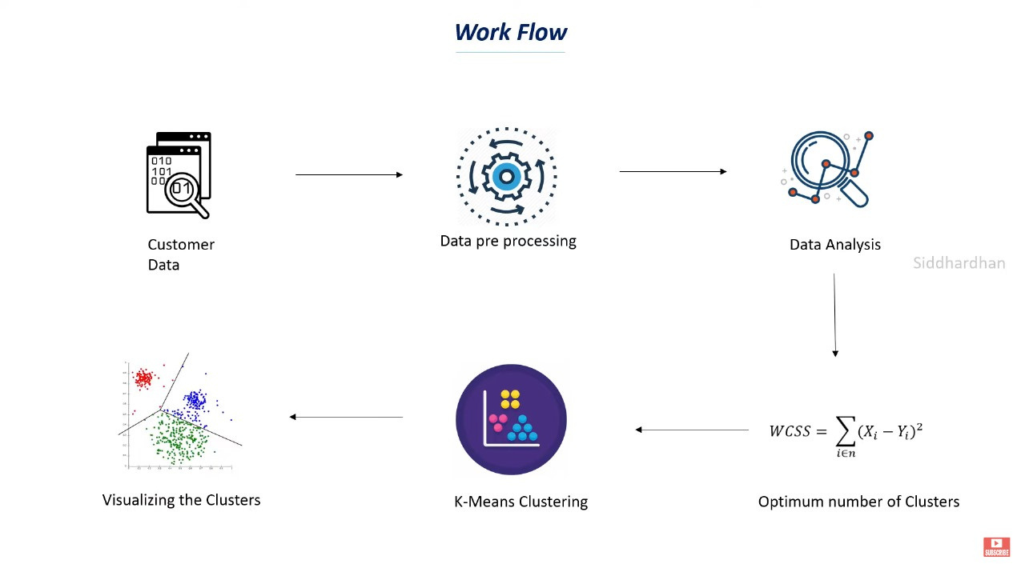
Architecture

Slide 9
1. Customer data:It typically includes demographic information, purchase history, and behavioral attributes, providing businesses with valuable insights into customer preferences and trends. Analyzing this data enables personalized marketing strategies and enhances overall customer experience.
2. Data Preprocessing: Cleanse and transform customer data, handling missing values and preparing it for analysis.
3. Data Analysis and WCSS Calculation:Analyze the preprocessed data and calculate Within Cluster Sum of Squares (WCSS) for different cluster numbers to determine the optimal number of clusters.
4. K-Means Clustering and Visualization: Apply the K-Means clustering algorithm with the optimal number of clusters, assigning customers to segments, and visualize the resulting clusters to gain insights into customer distribution based on distinct characteristics

Slide 10
Understanding the Data
Importing useful and required libraries
Check for the Null values
Preparing the data for clustering

Slide 11
2. Find the optimal number of clusters
K value should always be odd
Deciding optimal number of clusters to be used

Slide 12
3. Training a model using Unsupervised Learning Algorithm(K-Means)
Initializing our K-Means Model with the selected optimal no. of clusters.
Plot of Clusters, and gain intutions regarding our customers.

Slide 13
Module Description
1. Data Ingestion Module:
- Responsibility: Ingest data from various sources, such as databases or external APIs, and load it into the system for further processing.
2. Data Preprocessing Module:
- Responsibility: Handle data cleaning, transformation, and normalization. Address missing values, encode categorical variables, and prepare the data for feature selection.
3. Feature Selection Module:
- Responsibility: Allow users or the system to select relevant features (e.g., annual income, spending score) for clustering. Extract the chosen features from the preprocessed data.

Slide 14
4. K-Means Clustering Module:
- Responsibility: Implement the K-Means clustering algorithm to group customers into clusters based on the selected features. Determine the optimal number of clusters.
5. Cluster Analysis Module:
- Responsibility: Analyze the characteristics of each cluster, providing insights into the distinct customer segments created by the clustering algorithm.
6. Strategy Formulation Module:
- Responsibility: Formulate targeted marketing strategies and personalized services for each customer segment based on the cluster analysis. Collaborate with domain experts for effective strategy development.
7. Resource Optimization Module:
- Responsibility: Optimize resource allocation by considering the identified customer segments. Provide recommendations for efficient allocation of marketing resources and personnel..

Slide 15
8. Implementation and Monitoring Module:
- Responsibility: Implement the formulated strategies in the business operations. Continuously monitor customer behavior and strategy effectiveness, providing real-time feedback to decision-makers.
9. Customer Satisfaction Enhancement Module:
- Responsibility: Implement strategies and services tailored to each customer segment to enhance overall customer satisfaction.
10. Decision-Making Support Dashboard Module:
- Responsibility: Develop a dashboard that presents data-driven insights, visualizations, and key performance indicators to support strategic decision-making.
11. Iterative Feedback Loop Module:
- Responsibility: Establish a feedback loop for continuous improvement. Incorporate user feedback, adapt to market changes, and update the clustering model and strategy formulation iteratively.

Slide 16
Thank You

